Slide 1


DATA SCIENTIST CERTIFICATION
Jorge Alegre Portillo
jalegrep@gmail.com

Slide 2

INTRODUCTION
CATEGORICAL VARIABLES
NUMERIC/BOOLEAN VARIABLES
FEATURE | COUNT
Region | 10
Place Name | 187
Place Type | 11
Price | 3
FEATURE | TYPE
Rating | Range (0-5), Numeric
Reviews | Numeric
Delivery option | True / False
Dine in option | True / False
Takeout option | True / False

Slide 3
disclaimer
Conclusions in this presentation are based in statistical models.
Trade-off between complexity-accuracy and explainability has been made.
Due to the database had null values, some bias could have been introduced to the models.

Slide 4
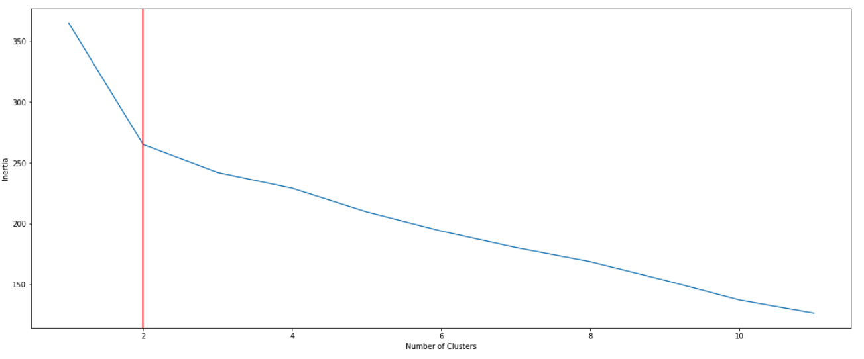
Segmentation using k-means elbow plot
Whenever inertia hits 2, the inertia tends to descrease slower

Slide 5
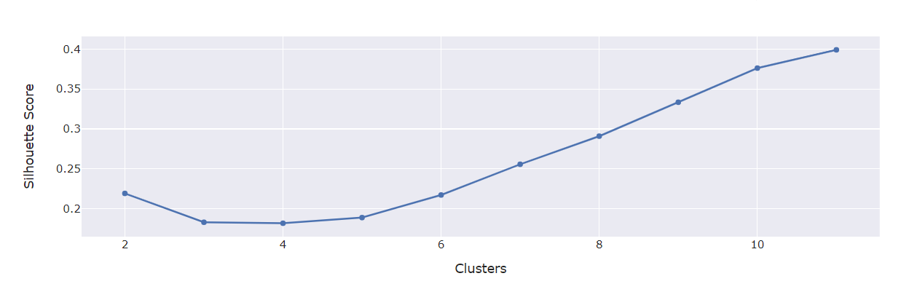
Segmentation using k-means Silhouette score
Maximums in 2 and 11.
2 has been chosen due to 11 would lose explainability

Slide 6
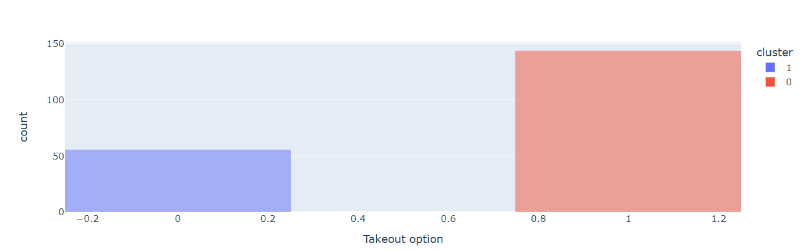
SEGMENTATION BY SERVICE
TAKE OUT OPTION
To cluster 0 belong the places with Takeout option

Slide 7
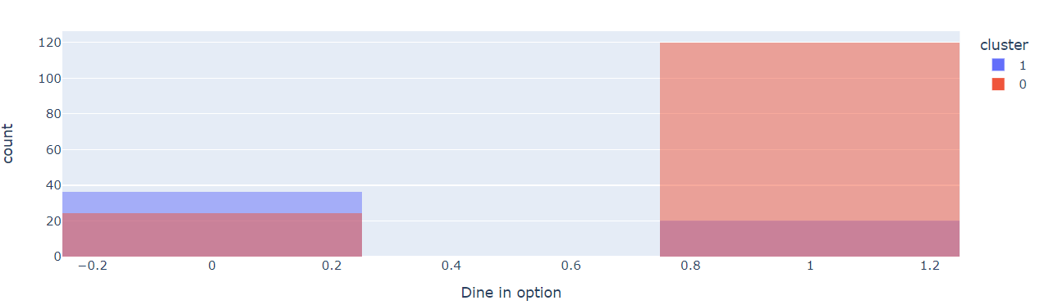
SEGMENTATION BY SERVICE
DINE IN OPTION
Most of the places with Dine in option are included in the cluster 0

Slide 8
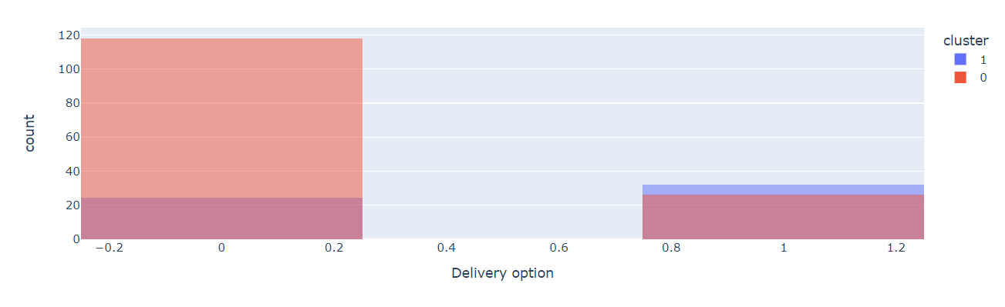
SEGMENTATION BY SERVICE
DELIVERY OPTION
In the cluster 0, normally they don’t have Delivery option

Slide 9
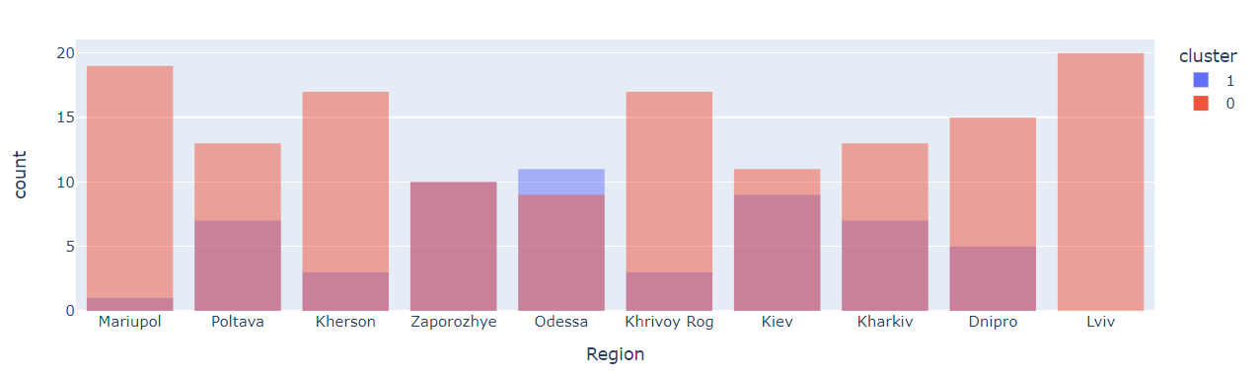
SEGMENTATION BY LOCATION
REGION

Slide 10
CONCLUSIONS
Finally, 2 groups have been selected to segment Ukraine.
We can see this segmentation from different points of view (Service & Location), Best: Take out option.

